Slide 1
Kubernetes 101
FHL/CY2019Q1

Slide 2
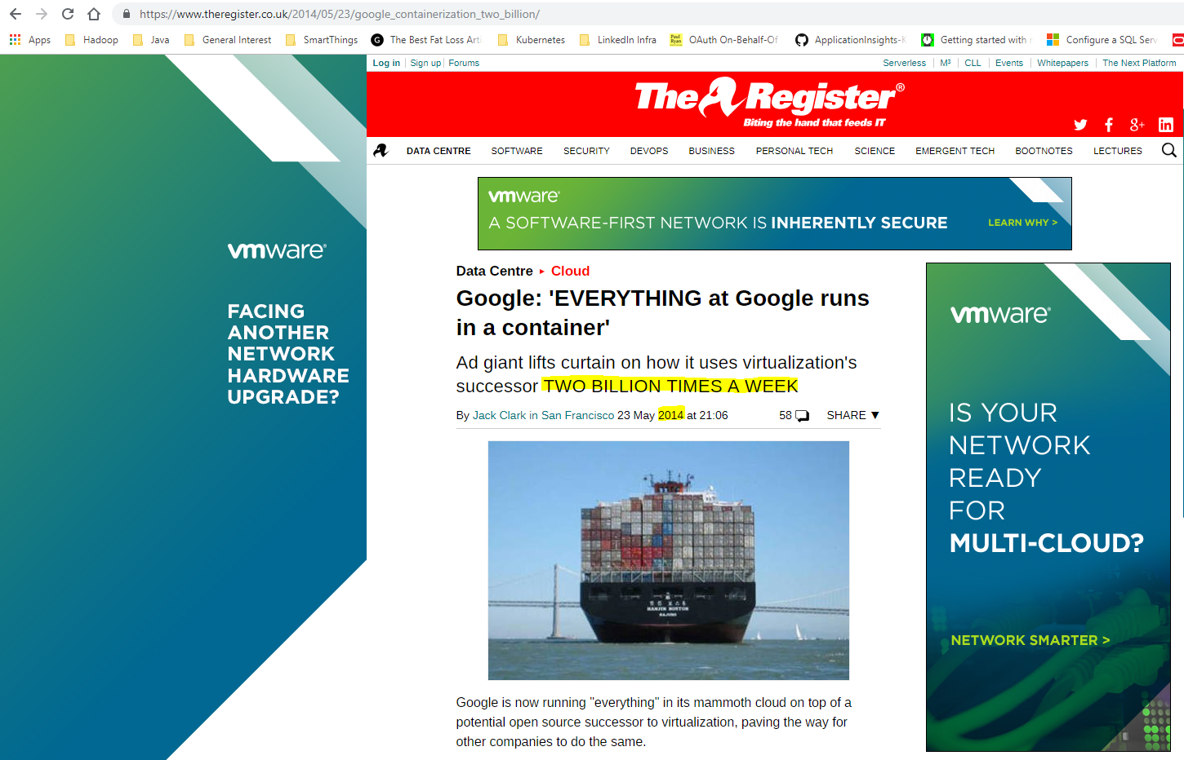
Learn from our competition…
“In the moment when I truly understand my enemy, understand him well enough to defeat him, then in that very moment I also love him…And then, in that very moment when I love them... I destroy them.”
- Andrew ‘Ender’ Wiggin
“If you know the enemy and know yourself, you need not fear the result of a hundred battles. If you know yourself but not the enemy, for every victory gained you will also suffer a defeat. If you know neither the enemy nor yourself, you will succumb in every battle.” - Sun Tzu

Slide 3
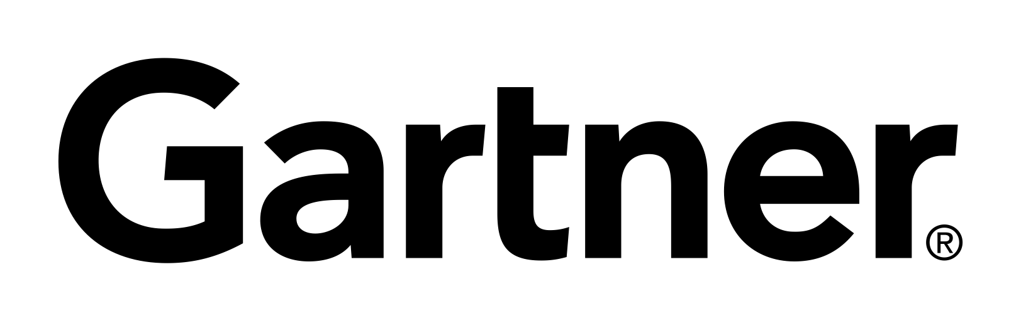
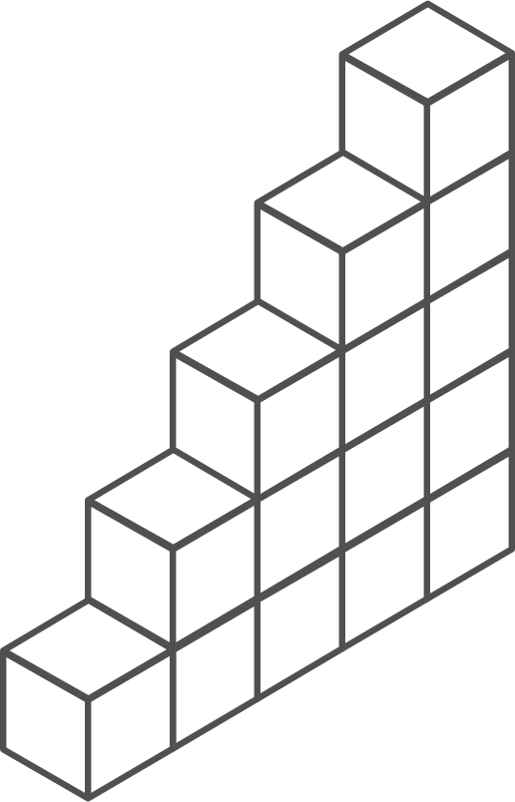
Containers momentum
“By 2020, more than 50% of enterprises will run mission-critical, containerized cloud-native applications in production.”
Half of container environment is orchestrated.¹
77%
77% of companies² who use container orchestrators choose Kubernetes.
The average size of a container deployment has grown 75% in one year. ¹
Larger companies are leading the adoption.¹
75%
50%
Nearly 50% of organizations¹ running 1000 or more hosts have adopted containers.
¹ Datadog report: 8 Surprising Facts About Real Docker Adoption
² CNCF survey: cloud-native-technologies-scaling-production-applications

Slide 4
Azure Kubernetes momentum
10x
5x
Last 12 months
Kubernetes on Azure usage grew 10x
Kubernetes on Azure customers grew 5x

Slide 5


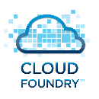


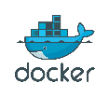
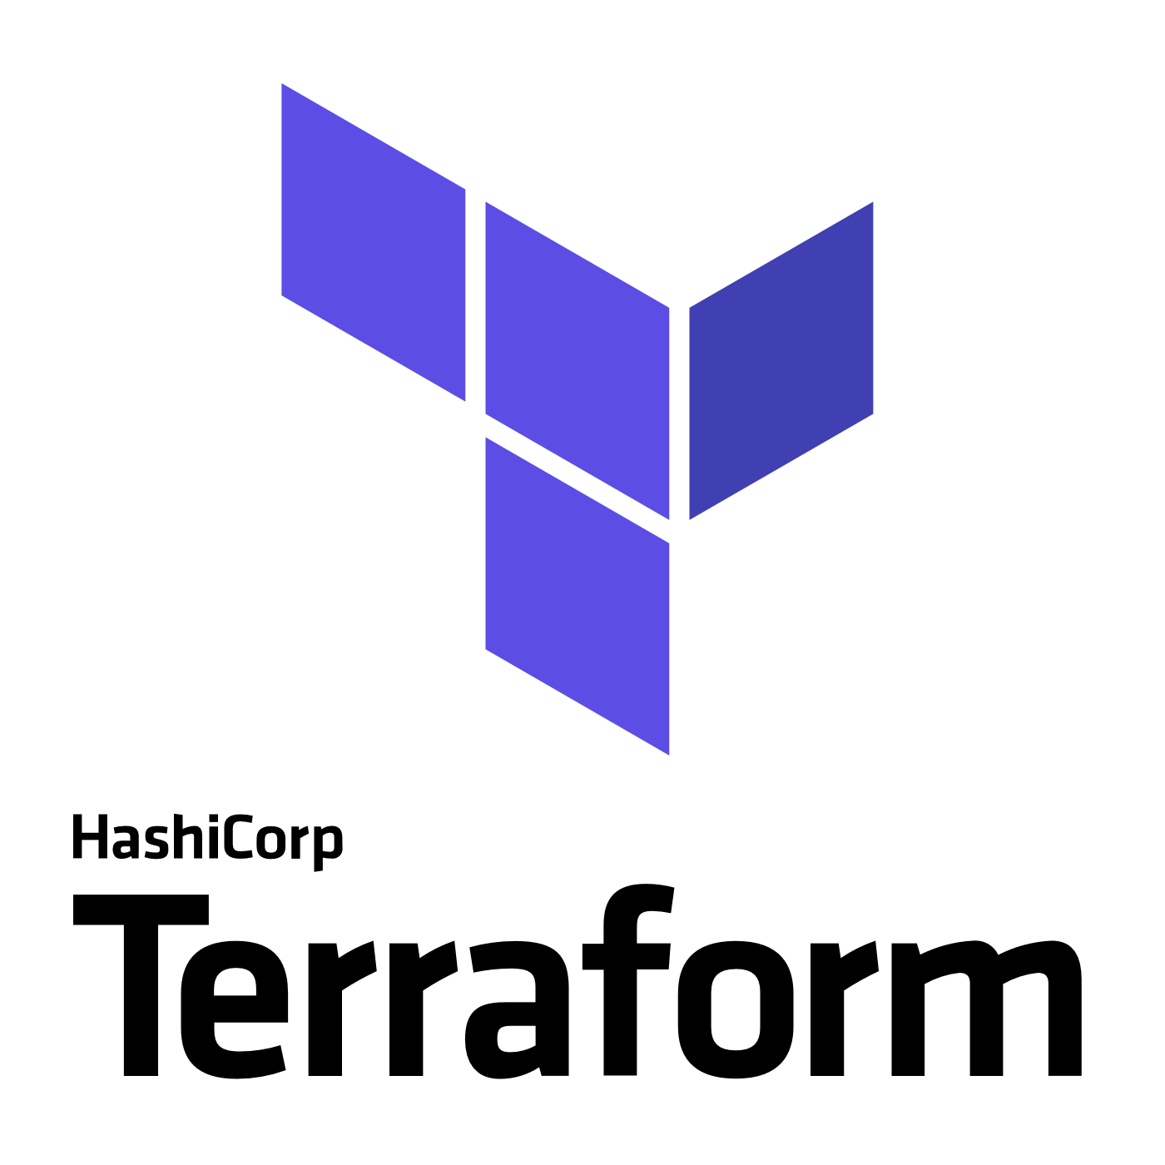


Be not afraid: Microsoft embraces open source
Azure is a strong platform for Open Source
Linux VMs are growing at ~2 times Windows VMs today
Microsoft announced GitHub acquisition
1 in 3 VMs on Azure are Linux
~60% of 3rd party Azure Marketplace images are open source
Partnerships
#2 overall individual contributor to Kubernetes (Brendan Burns)
#4 overall individual contributor to Docker (John Howard)
#1-3 overall individual contributors to Helm
70 Microsoft employees have made contributions to Kubernetes
“Microsoft Joins Cloud Native Computing Foundation as Platinum Member”

Slide 6
Peering Behind The Curtain
Umm, ok. Containers and Kubernetes are magic. I get it… What ARE they, exactly?

Slide 7
What is a container?
App
Container
App
Virtual machines
Containers
Virtualize the hardware
VMs as units of scaling
Virtualize the operating system
Applications as units of scaling

Slide 8
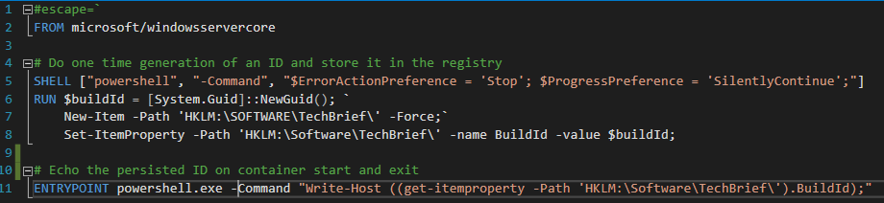
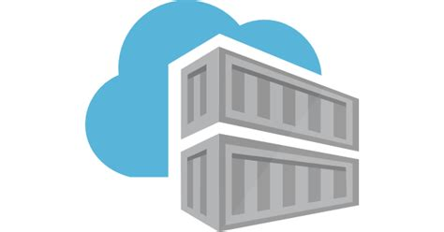
Containers: A Simple Example
Developer
Dockerfile
Script “Machine Setup” in Dockerfile
Check-in
Build
D:\git\ContainerTechBrief>docker build . -t brief:latest
Sending build context to Docker daemon 37.89kB
…
Successfully built 14ebd4f59682
Successfully tagged brief:latest
Run #1
D:\git\ContainerTechBrief>docker run brief:latest
85b0ace3-e8e3-42b1-b896-18c20e4bec71
Run #2 (on a different machine)
D:\git\ContainerTechBrief>docker run brief:latest
85b0ace3-e8e3-42b1-b896-18c20e4bec71
Built by VSTS
Container Image Saved to Azure Container Registry
This looks like a toy at first glance, but it’s not.
Arbitrarily complex imperative logic, affecting local machine state, which would normally be run at Setup time is moved to Build time. Imagine executing an entire MSI this way.
Immutable Image Retrieved and Run Everywhere

Slide 9
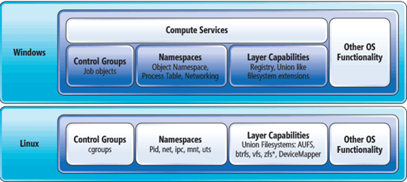
Containers: Capabilities & Advantages
Ideal for Microservice Developers:
Application centric – app developers only care about their apps
Build once, run anywhere and anywhen => agile and predictable
Manage app binary dependencies at build time and only those
Ideal for Microservice Platform Providers:
Standard unit of packaging, deployment, execution and orchestration for any app for automation at scale
Isolation for host and other apps – CPU, memory, network, filesystem = reliability
Easy to relocate and binpack on machines.
Easy to roll-forward/roll-back – just start a different version of the container
Immutability: Container Registry and Filesystem Contents saved at build time and loaded/reset efficiently on start.
Visibility: Host OS objects are invisible, Container looks like a machine.
Resource Isolation: Utilization strongly bound (CPU, Memory, IO)
External State: External Data (e.g. DBs) can be mounted into the container namespace from the host OS if needed.
Net: Containers are a key accelerator for microservices adoption.
Notes:
https://msdn.microsoft.com/en-us/magazine/mt797649.aspx

Slide 10
The elements of orchestration
Containers alone are awesome, but how do you manage them at scale?
Scheduling
Affinity/anti-affinity
Health monitoring
Failover
Scaling
Networking
Service discovery
Coordinated app upgrades

Slide 11
Kubernetes: empowering you to do more
Portable
Public, private, hybrid, multi-cloud
Extensible
Modular, pluggable, hookable, composable
Self-healing
Auto-placement, auto-restart, auto-replication, auto-scaling
Deploy your applications quickly and predictably
Scale your applications on the fly
Roll out new features seamlessly
Limit hardware usage to required resources only

Slide 12
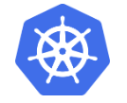
Kubernetes project
Mature and stable open source project with large community (2k contributors), focused working groups and regular releases.
Has ecosystem of open source tools, extensions
Container orchestrator platform offered by all major cloud service providers
Extensible, non-opinionated – significant degree of flexibility or customization
Proven, tested and robust platform
Significant "in-house" expertise – Azure Kubernetes Service team
"Run Anywhere“ – Abstracts away physical hosting details, allowing workloads to be relocated, scaled, and more.
Supports both Windows and Linux workloads
Windows Server team is committed to support K8s

Slide 13
Kubernetes: The User View
User
User: “I submit my manifest, and I’m done!”
App Manifest
Azure managed control plane
Kubernetes API endpoint
Self-managed master node(s)
Submit To Prod
API server
etcd Store
Scheduler
Controller Manager
Cloud Controller
Schedule pods
Customer Machines
Docker
Docker
Docker
Docker
Docker
Pods
Pods
Pods
Pods
Pods

Slide 14
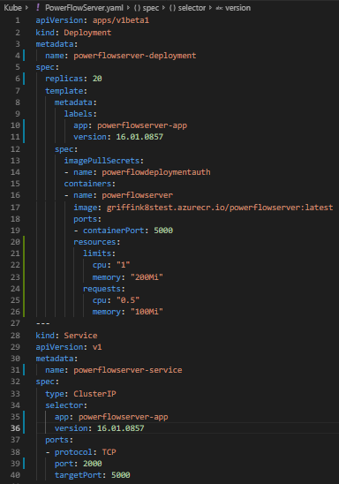
Kubernetes: A Simple Example
Deploy this image, please!
Keep 20 copies up at all times, no matter what happens!
Make sure it doesn’t overwhelm my machine!
Light up a single DNS record and IP that routes traffic to the live instances of my container tagged with:
- app = powerflowserver-app
- version = 16.01.0857

Slide 15
Kubernetes Architecture 101
User/service traffic
Kubernetes control
Worker node
Kubernetes users communicate with API server and apply desired state
kubelet
kube-proxy
Master node
Docker
Master nodes actively enforce desired state on worker nodes
Pod
Pod
API server
Containers
Containers
Worker nodes support communication between containers
-controller-manager
-scheduler
Worker node
kubelet
kube-proxy
Worker nodes support communication from the exterior network
replication, namespace, serviceaccounts, etc.
etcd
Docker
Pod
Pod
Containers
Containers

